Slide 1
Software
Re-Engineering
Credit: Engr. Sehar Gul(Lecture Slides)

Slide 2
Agenda
Starting Point for Refactoring

Slide 3
Emotions
Fear
Frustration

Slide 4
Fear
Every time I touch a line of code, I break something completely unrelated.
It’s just too fragile to work with.
I should get in and get out without touching anything I don’t absolutely have to handle.

Slide 5
Fear
Let’s say you’re tasked with maintaining your company’s employee time-tracking system, codenamed TimeTrack.
It’s a legacy Java application that was developed in-house years ago, mostly by just one developer who has now left the company.
Unfortunately, he left little in the way of tests or documentation, and the only useful document you could find was the architecture diagram in figure

Slide 6
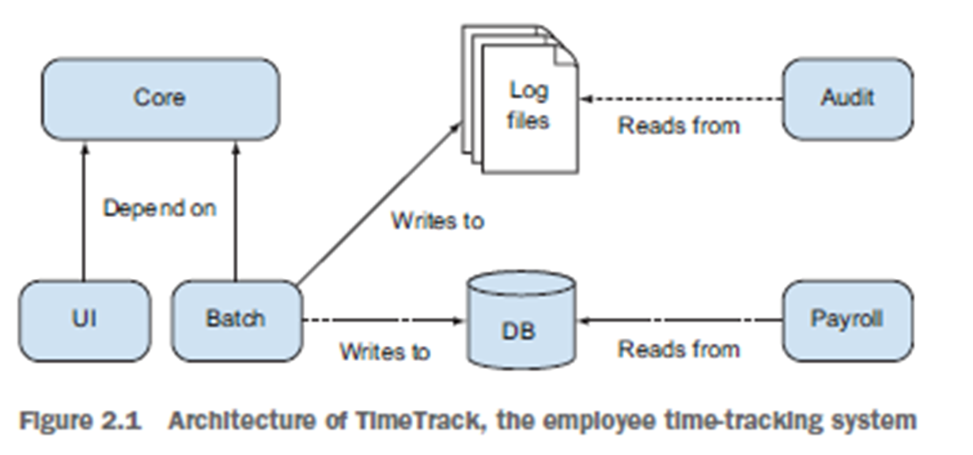
Fear

Slide 7
Fear
The application has a number of components
Core implements the complex business logic and includes a number of utility classes.
UI provides a web interface for employees to fill in their hours worked.
It also provides functionality for managers to construct and download reports about how employees are spending their time.
Batch contains a number of nightly batches that insert data into the Payroll system’s database.
Audit collects and processes the logs output by the nightly batches in order to generate compliance reports for the annual tax audit.

Slide 8
Overcoming Fear
Open up the Core project in your IDE and try renaming methods, moving methods between classes, introducing new interfaces, adding comments—basically anything you can think of that makes the code cleaner and more readable.
This process is known as exploratory refactoring

Slide 9
Exploratory Refactoring
Benefits:
Increased code understanding
Better issue resolving in future
Increase readability of the code

Slide 10
Exploratory Refactoring
When performing exploratory refactoring, always remember that you have strong allies you can rely on to protect you.
The version control system
The IDE
The Compiler
Other Developers

Slide 11
The version control system
If your refactoring gets out of hand and you don’t feel confident that the code still works correctly, all it takes is one command to revert your changes and put the code back into a known, safe state.

Slide 12
The IDE
Modern IDEs such as Eclipse and IntelliJ offer powerful refactoring functionality.
They are capable of performing a wide range of standard refactoring, and they can do in milliseconds what would take a human minutes or hours of tedious editing to achieve.
What’s more, they can perform these refactoring much more safely than a human—an IDE never makes a typo!

Slide 13
The Compiler
Assuming you’re working with a statically compiled language such as Java, the compiler can help you discover the effects of your changes quickly.
After each refactoring step, run the compiler and check that you haven’t introduced any compilation errors. Using the compiler to obtain quick feedback like this is often called leaning on the compiler.
If you’re using a dynamic language such as Python or Ruby, there’s no compiler to lean on, so you’ll have to be more careful.
This is one reason why many Ruby developers are so passionate about automated testing. They use tests to provide the support that they can’t get from the compiler.

Slide 14
Other Developers
Everybody makes mistakes, so it’s always a good idea to have a coworker review the changes you’ve made.
Alternatively, you may want to try working in a pair when you refactor.
One developer (the “navigator”) can check for mistakes and provide advice while the other developer (the “driver”) focuses on performing the refactoring

Slide 15
Characterization Tests
As a complement to explanatory refactoring, you could also try adding characterization tests (a coin termed by Michael Feathers).
These are tests that demonstrate how a given part of the system currently behaves.
Note that the goal is to describe how the system actually behaves, which may not necessarily be the same as what’s written in the spec.
When it comes to legacy code, preserving the existing behavior is usually the most important goal.

Slide 16
Characterization Tests
Writing these characterization tests can help to solidify your understanding of the code’s behavior, and they give you the freedom to make changes to the code in the future, safe in the knowledge that you’ve protected yourself against unintended regressions.
Say the TimeTrack application’s Core component includes a number of similar, but subtly different, utility methods for manipulating and formatting dates and timestamps.
They’re unhelpfully named things like convertDate, convertDate2, convertDate_new, and so on. You might want to write some characterization tests to work out exactly what each of these methods does and how they differ from each other.

Slide 17
Frustration

Slide 18
Frustration
I wouldn’t even know where to begin fixing this big ball of mud.
Every class is as bad as the previous (or next) one. Let’s pick classes at random and start refactoring.
I’ve had it with this WidgetManagerFactoryImpl! I’m not doing anything else until I’ve rewritten it

Slide 19
Loss of Motivation
You give up your refactoring efforts as hopeless, and resign yourself to a future of legacy hard work.
The software seems to be disaster, and there’s no way to save it

Slide 20
Desperate Measures
You start randomly stabbing at the codebase with a refactoring tool
You’ll probably start with your least favorite class, the one you’ve had your eye on for a few month now, and after that you’ll move on to a few more randomly chosen classes until your energizing urges have been satisfied
At this point, you go back to doing “real” work, until a few weeks later when enough frustration builds up and forces you to go through the same cycle again

Slide 21
Solution
We need a way to maintain motivation and remind ourselves that our refactoring efforts are making a difference.
We can do this by choosing one or more metrics that indicate the quality of the code.
As for the desperate refactoring raids, it seems like we need a more systematic approach if we’re going to make a real impact on improving the quality of the code

Slide 22
Solution
To summarize, we want to gather data about our software for two reasons:
To show the quality of the software and how that quality is changing over time.
To decide what our next refactoring target should be.
This may be a part of the code that is quantitatively worse than others (according to some measure of goodness), or it may be code whose refactoring provides a lot of value to the team, perhaps because it’s a class that’s often touched by developers when they implement bug fixes or new features

Slide 23
Gathering useful data about your software
We want to gather metrics about legacy software in order to help us answer the following questions
What state is the code in to start with? Is it really in as bad shape as you think?
What should be your next target for refactoring at any given time?
How much progress are you making with your refactoring? Are you improving the quality fast enough to keep up with the entropy introduced by new changes?

Slide 24
Gathering useful data about your software
First we need to decide what to measure.
This depends largely on the particular software, but the simple answer is measure everything you can.
You want as much raw data as you can get your hands on, to help guide you in your decision-making.
This may include some of the metrics discussed in next few slides?

Slide 25
Bugs and coding standard violations
A bug-finding tool such as FindBugs may flag any code that fails to close an InputStream that it has opened, because this may result in a resource leak and should thus be considered a bug.
A style-checking tool such as Checkstyle searches for code that violates a given set of style rules. It may flag any code that’s incorrectly indented or is missing a Javadoc comment.

Slide 26
Performance Test
If you wanted to test the performance of the Audit component, you could start with the following test:
Start the system in a known state.
Feed it 1 million lines of dummy log data.
Time how long it takes to process the data and generate an audit report.
Shut down the system and clean up.

Slide 27
Performance Test
If starting up the whole system before the test (and tearing it down afterward) is slow and cumbersome, you may instead want to write more fine-grained tests that measure the performance of individual subsystems rather than the system as a whole

Slide 28

Performance Test
Say the Audit component has three stages in its processing pipeline, as shown in figure:
parsing the incoming log data,
calculating the report’s content,
and rendering the report and writing it to a file.
You may want to write separate performance tests for each stage, so that you can find the bottlenecks in the system.

Slide 29
Performance Test
Say the Audit component has three stages in its processing pipeline, as shown in figure:
parsing the incoming log data,
calculating the report’s content,
and rendering the report and writing it to a file.
But if the code for each processing stage is highly coupled, it’s difficult to test any one stage in isolation.
You’ll need to refactor the code into three separate classes before you can write your performance tests

Slide 30
MONITORING PERFORMANCE IN PRODUCTION
If your software is a web application, it’s easy to collect performance data from the production system.
Any decent web server will be able to output the processing time of every request to a log file.
You could write a simple script to aggregate this data to calculate percentile response times per hour, per day, and so on.

Slide 31
Error Counts
Measuring performance is all well and good, but it doesn’t matter how fast your code runs if it’s not doing its job correctly.
A count of the number of errors happening in production is a simple but useful indicator of the quality of your software, as seen from the end-user’s perspective.
If your software is a website, you could count the number of 500 Internal Server Error responses that your server generates per day.
This information should be available in your web server’s access logs, so you could write a script to count the error responses every day and email this number to your developers.

Slide 32
Timing common Tasks
TIME TO SET UP THE DEVELOPMENT ENVIRONMENT FROM SCRATCH
TIME TAKEN TO RELEASE OR DEPLOY THE PROJECT
AVERAGE TIME TO FIX A BUG

Slide 33
Commonly used files
Knowing which files in your project are edited most often can be very useful when choosing your next refactoring target.
If one particular class is edited by developers very often, it’s an ideal target for refactoring

Slide 34
Measure everything you can
Of course, just because you can measure something, it doesn’t mean it’s necessarily useful data.
You could measure the number of Zs in your codebase, the average number of fingers on a developer’s hand, or the distance between the production server and the moon, but it’s hard to see how these relate to quality!
Silly examples aside, it’s always better to have too much information than not enough. A good rule of thumb is, if in doubt, measure it.

Slide 35
Thank You

